Slide 1
Basic Computer Organization & Design

Slide 2
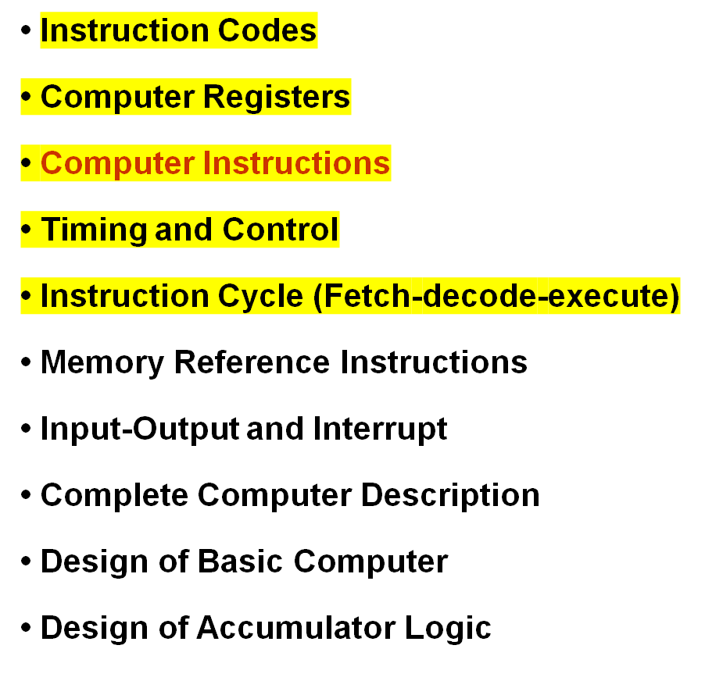
BASIC COMPUTER ORGANIZATION AND DESIGN

Slide 3
INTRODUCTION
Every different processor type has its own design (different registers, buses, microoperations, machine instructions, etc)
Modern processor is a very complex device
It contains
  Many registers
  Multiple arithmetic units, for both integer and floating point calculations
  The ability to pipeline several consecutive instructions to speed execution
  Etc.
However, to understand how processors work, we will start with a simplified processor model. This is similar to what real processors were like ~25 years ago
M. Morris Mano introduces a simple processor model he calls the Basic Computer.

Slide 4
INSTRUCTION CODES
Program
  A sequence of (machine) instructions
(Machine) Instruction Codes
  A group of bits that tell the computer to perform a specific operation (a sequence of micro-operation)
  It is usually divided into parts, each having its own particular interprettion.
The instructions of a program, along with any needed data are stored in memory
The CPU reads the next instruction from memory
It is placed in an Instruction Register (IR)
Control circuitry in control unit then translates the instruction into the sequence of microoperations necessary to implement it

Slide 5
THE BASIC COMPUTER
The Basic Computer has two components, a processor and memory.
The memory has 4096 words in it
  4096 word = 2¹², so it takes 12 bits to select a word in memory
Each word is 16 bits long
CPU
RAM (4096 x 16)
0
15
0
4095

Slide 6
INSTRUCTION FORMAT
A computer instruction is often divided into two parts
  An opcode (Operation Code) that specifies the operation for that instruction
  An address that specifies the registers and/or locations in memory to use for that operation
In the Basic Computer, since the memory contains 4096 (= 2¹²) words, we needs 12 bit to specify which memory address this instruction will use
In the Basic Computer, bit 15 of the instruction specifies the addressing mode (0: direct addressing, 1: indirect addressing)
Since the memory words, and hence the instructions, are 16 bits long, that leaves 3 bits for the instruction’s opcode
Instruction Format
15
14
12
11
0
I
Opcode
Address
Addressing
mode

Slide 7





The address field of an instruction can represent either
  Direct address: the address in memory of the data to use (the address of the operand), or
  Indirect address: the address in memory of the address in memory of the data to use
Effective Address (EA)
  The address, that can be directly used without modification to access an operand for a computation-type instruction, or as the target address for a branch-type instruction
Direct addressing
Indirect addressing
22
ADD
35
ADD
300
457
Operand
1350
Operand
+
+
AC
AC

Slide 8
COMPUTER REGISTERS
Registers in the Basic Computer
11
0
PC
Memory
11
0
4096 x 16
AR
15
0
IR
CPU
15
0
15
0
TR
DR
7
0
7
0
15
0
OUTR
INPR
AC
List of BC Registers
  DR 16 Data Register Holds memory operand
  AR 12 Address Register Holds address for memory
  AC 16 Accumulator Processor register
  IR 16 Instruction Register Holds instruction code
  PC 12 Program Counter Holds address of instruction
  TR 16 Temporary Register Holds temporary data
  INPR 8 Input Register Holds input character
  OUTR 8 Output Register Holds output character

Slide 9
PROCESSOR REGISTERS
A processor has many registers to hold instructions, addresses, data, etc
The processor has a register, the Program Counter (PC) that holds the memory address of the next instruction to get
  Since the memory in the Basic Computer only has 4096 locations, the PC only needs 12 bits
In a direct or indirect addressing, the processor needs to keep track of what locations in memory it is addressing: The Address Register (AR) is used for this
  The AR is a 12 bit register in the Basic Computer
When an operand is found, using either direct or indirect addressing, it is placed in the Data Register (DR). The processor then uses this value as data for its operation.
The Basic Computer has a single general purpose register – the Accumulator (AC)

Slide 10
PROCESSOR REGISTERS
The significance of a general purpose register is that it can be referred to in instructions
  e.g. load AC with the contents of a specific memory location; store the contents of AC into a specified memory location
Often a processor will need a scratch register to store intermediate results or other temporary data; in the Basic Computer this is the Temporary Register (TR)
The Basic Computer uses a very simple model of input/output (I/O) operations
  Input devices are considered to send 8 bits of character data to the processor
  The processor can send 8 bits of character data to output devices
The Input Register (INPR) holds an 8 bit character gotten from an input device
The Output Register (OUTR) holds an 8 bit character to be send to an output device

Slide 11
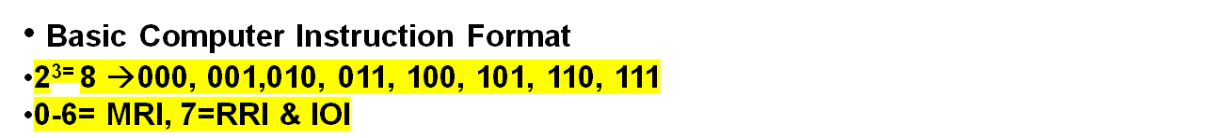


COMPUTER INSTRUCTIONS
Memory-Reference Instructions (OP-code = 000 ~ 110)
15 14
12 11
0
I
Opcode
Address
Register-Reference Instructions (OP-code = 111, I = 0)
15
12 11
0
Register operation
Input-Output Instructions (OP-code =111, I = 1)
15
12 11
0
I/O operation

Slide 12
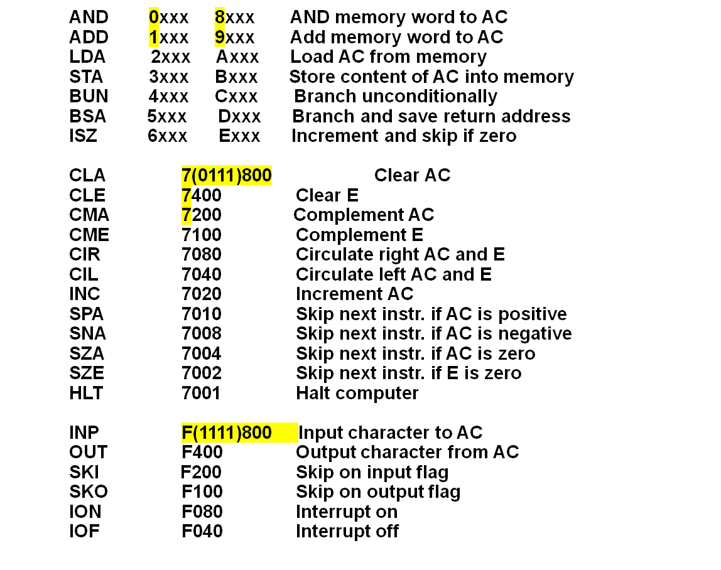
COMPUTER INSTRUCTIONS
Hex Code
Symbol I = 0 I = 1 Description

Slide 13
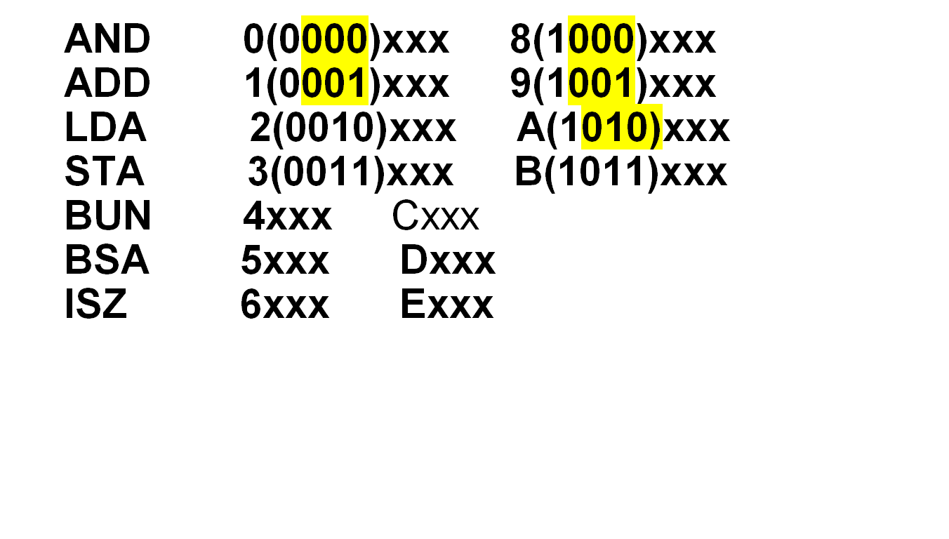

Slide 14
Common Bus System
Basic computers has 6 registers, a memory unit and a control unit.
The registers in the Basic Computer are connected using a common bus.
This gives a savings in circuitry over complete connections between registers.

Slide 15
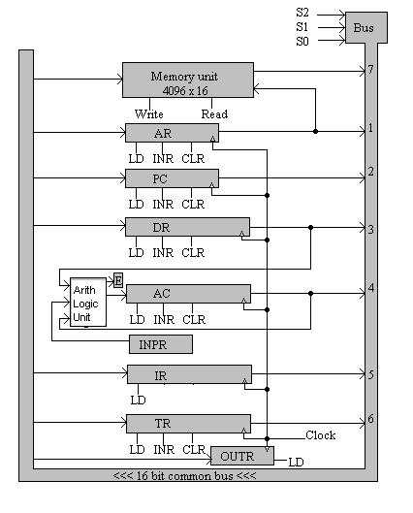
Common Bus System

Slide 16
INSTRUCTION SET COMPLETENESS
A computer should have a set of instructions so that the user can
construct machine language programs to evaluate any function that is known to be computable.
Instruction Types
  Functional Instructions
  - Arithmetic, logic, and shift instructions
  - ADD, CMA, INC, CIR, CIL, AND, CLA
  Transfer Instructions
  - Data transfers between the main memory
  and the processor registers
  - LDA, STA
  Control Instructions
  - Program sequencing and control
  - BUN, BSA, ISZ
  Input/Output Instructions
  - Input and output
  - INP, OUT

Slide 17
CONTROL UNIT
Control unit (CU) of a processor translates from machine instructions to the control signals for the microoperations that implement them
Control units are implemented in one of two ways
Hardwired Control
  CU is made up of sequential and combinational circuits to generate the control signals
Microprogrammed Control
  A control memory on the processor contains microprograms that activate the necessary control signals
We will consider a hardwired implementation of the control unit for the Basic Computer

Slide 18
TIMING AND CONTROL
Control unit of Basic Computer
Instruction register (IR)
15
14 13 12
11 - 0
Other inputs
3 x 8
decoder
7 6 5 4 3 2 1 0
D
0
Combinational
Control
logic
I
D
Control
signals
7
T
15
T
0
15 14 . . . . 2 1 0
4 x 16
decoder
4-bit
Increment (INR)
sequence
Clear (CLR)
counter
Clock
(SC)

Slide 19
INSTRUCTION CYCLE
In Basic Computer, a machine instruction is executed in the following cycle:
  Fetch an instruction from memory
  Decode the instruction
  Read the effective address from memory if the instruction has an indirect address
  Execute the instruction
After an instruction is executed, the cycle starts again at step 1, for the next instruction
Note: Every different processor has its own (different) instruction cycle

Slide 20
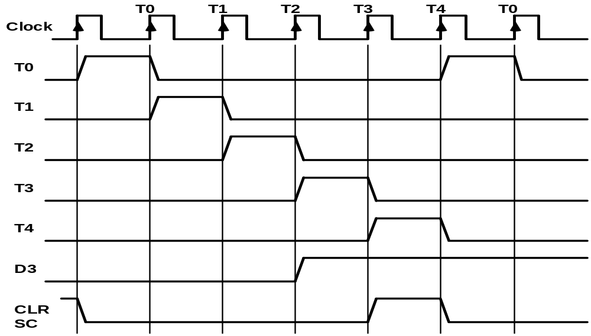
TIMING SIGNALS
- Generated by 4-bit sequence counter and 4×16 decoder
- The SC can be incremented or cleared.
- Example: T₀, T₁, T₂, T₃, T₄, T₀, T₁, . . .
Assume: At time T₄, SC is cleared to 0 if decoder output D3 is active.
D₃T₄: SC ← 0

Slide 21
FETCH and DECODE
• Fetch and Decode
T0: AR ← PC (S₀S₁S₂=010, T0=1)
T1: IR ← M [AR], PC ← PC + 1 (S0S1S2=111, T1=1)
T2: D0, . . . , D7 ← Decode IR(12-14), AR ← IR(0-11), I ← IR(15)
T1
S₂
T0
S₁
Bus
S₀
Memory
7
unit
Address
Read
AR
1
LD
PC
2
INR
IR
5
LD
Clock
Common bus

Slide 22
DETERMINE THE TYPE OF INSTRUCTION
Start
SC ← 0
AR
←
PC
T0
T1
IR
←
M[AR],
PC
←
PC + 1
T2
Decode Opcode in IR(12-14),
AR
←
IR(0-11),
←
I
IR(15)
(Register or I/O) = 1
D7
= 0 (Memory-reference)
(I/O) = 1
= 0 (register)
(indirect) = 1
= 0 (direct)
I
I
T3
T3
T3
T3
Execute
Execute
AR
←
M[AR]
Nothing
input-output
register-reference
instruction
instruction
SC
←
0
SC
←
0
Execute
T4
memory-reference
instruction
SC
←
0
D'7IT3: AR ← M[AR]
D'7I'T3: Nothing
D7I'T3: Execute a register-reference instr.
D7IT3: Execute an input-output instr.

